Slide 1
Social Choice
Copyright © 2019 Hal R. Varian

Slide 2

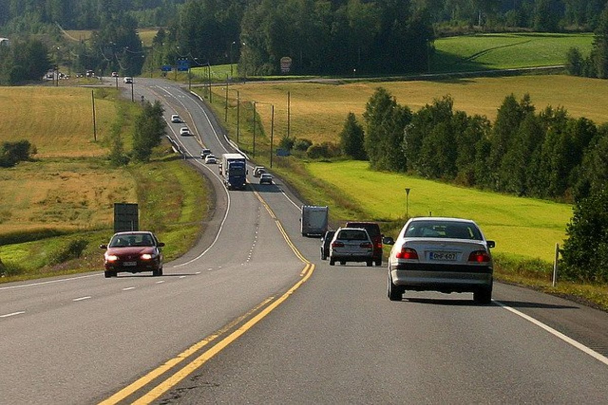
Introduction
In general, there might not always be a unique efficient choice.
For example, it is efficient if everyone drove on the left-hand side. But it is also efficient if everyone drove on the right-hand side.
Recall from last week that there can be many pareto efficient allocations.
How do we choose which pareto efficient allocation is the “best”?
Different people can have different opinions…
Contract curve

Slide 3
Introduction
Hence, even if people agree on a set of outcomes that they would want to choose from, they might still disagree on the particular outcome.
You and your friends might agree on a holiday, but don’t agree on where to go.
Society might agree on COVID vaccination, but disagree on how it is implemented.
In this lecture, we consider how social choices can be made in such situations.

Slide 4
Social Choice
Particularly, we are interested in situations where:
A decision needs to be made among a set of alternatives.
The decision affects a group of individuals (the “society”).
Individuals (typically) have different preferences towards the alternatives.
How can we use people’s preferences to reach a social choice?
In other words, we want some way to aggregate individual preferences to social preferences.

Slide 5
A Model of Social Choice

Slide 6
Alternatives
Let us define an alternative as a potential option out of many.
We will consider a (social) choice which needs to be made out from a set of alternatives.
In the context of the previous lecture, this could refer to the set of feasible allocations in the Edgeworth box.
However, much more general:
Where to eat lunch? (Macs, KFC, Hive…)
Which president to vote for? (Trump, Biden …)
…

Slide 7
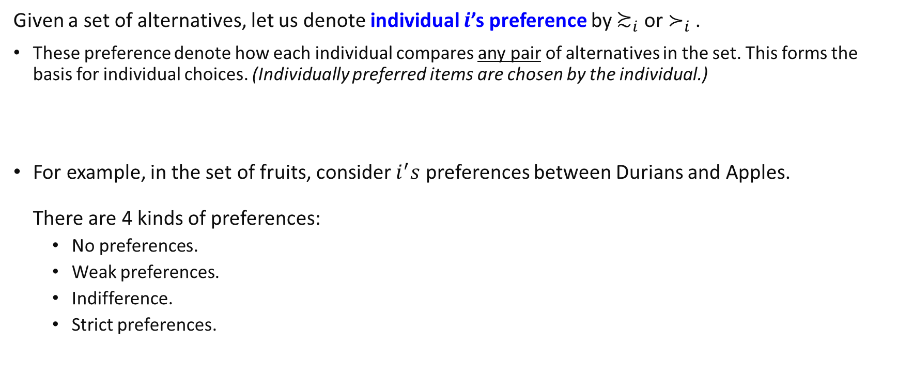
Individual Preferences
Given a set of alternatives, let us denote individual $i$’s preference by $≿_{i}$ or $≻_{i}$.
These preference denote how each individual compares any pair of alternatives in the set. This forms the basis for individual choices. (Individually preferred items are chosen by the individual.)
For example, in the set of fruits, consider $i^{′}s$ preferences between Durians and Apples. There are 4 kinds of preferences:
No preferences.
Weak preferences.
Indifference.
Strict preferences.

Slide 8
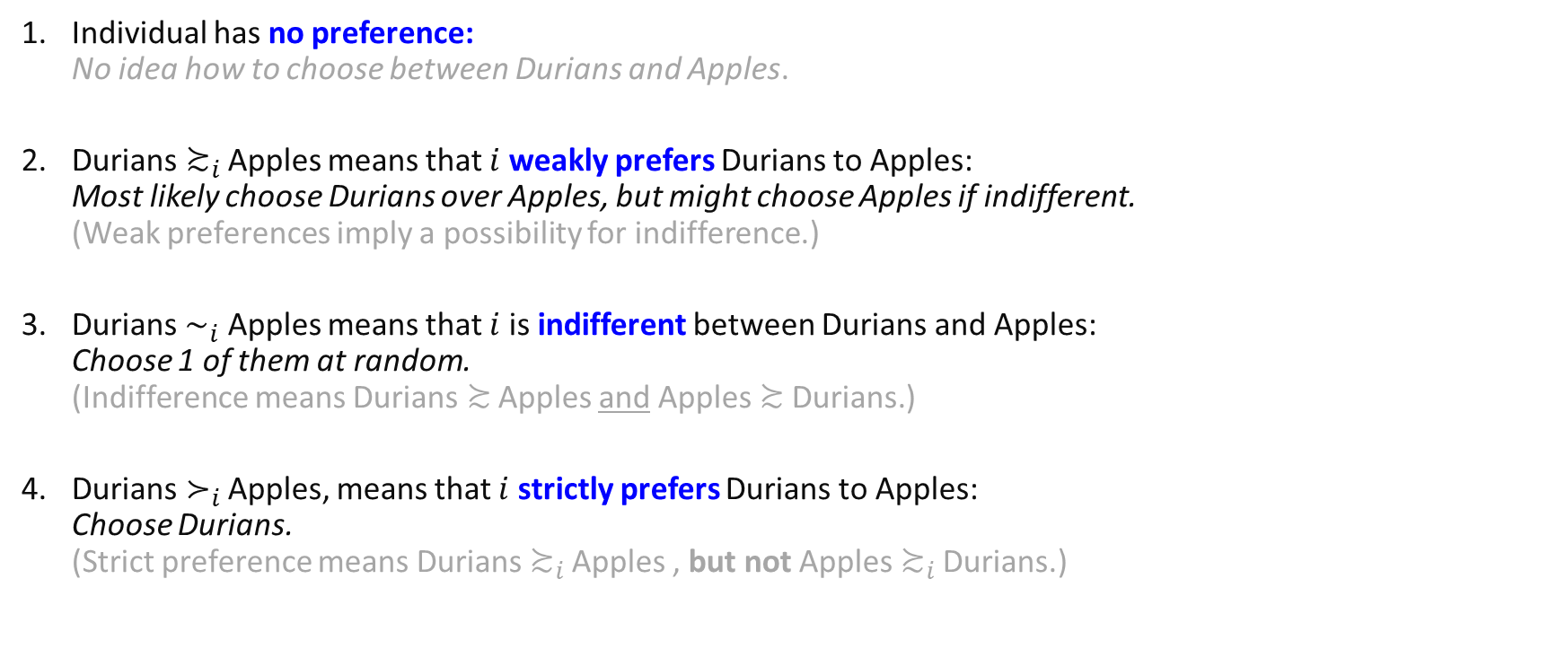
Individual Preferences
Individual has no preference: No idea how to choose between Durians and Apples.
Durians$≿_{i}$Apples means that $i$ weakly prefers Durians to Apples: Most likely choose Durians over Apples, but might choose Apples if indifferent. (Weak preferences imply a possibility for indifference.)
Durians $∼_{i}$ Apples means that $i$ is indifferent between Durians and Apples: Choose 1 of them at random. (Indifference means Durians$≿$ Apples and Apples$≿$Durians.)
Durians$≻_{i}$ Apples, means that $i$ strictly prefers Durians to Apples: Choose Durians. (Strict preference means Durians$≿_{i}$ Apples , but not Apples$≿_{i}$ Durians.)

Slide 9

Individual Preferences
Preferences are “rational” or well-defined if they satisfy the following properties:
Transitivity: if $A≿B$ and $B≿C$, then $A≿C$ I.e. if one weakly prefers apples to oranges and oranges to pears, then one must also weakly prefer apples to pears.
Completeness: for any two alternatives $A,B$, either $A≻B$ or $B≻A$ or $A∼B$ I.e. one must have preferences over any two alternatives and hence be able to make a choice. (Notice here that indifference between A and B is also a preference and part of completeness!
In most examples in this course, we will focus on people having strict preferences, but do keep the above definitions in mind!
Notes:
1) also implies the following strict and indifferent versions of transitivity: (i) if $A≻B$ and $B≻C$, then $A≻C$ ; (ii) if $A∼B$ and $B∼C$, then $A∼C$

Slide 10
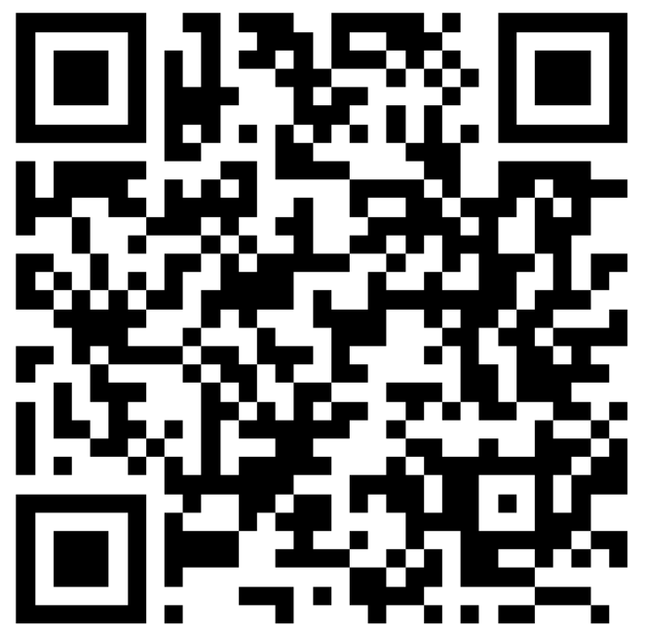
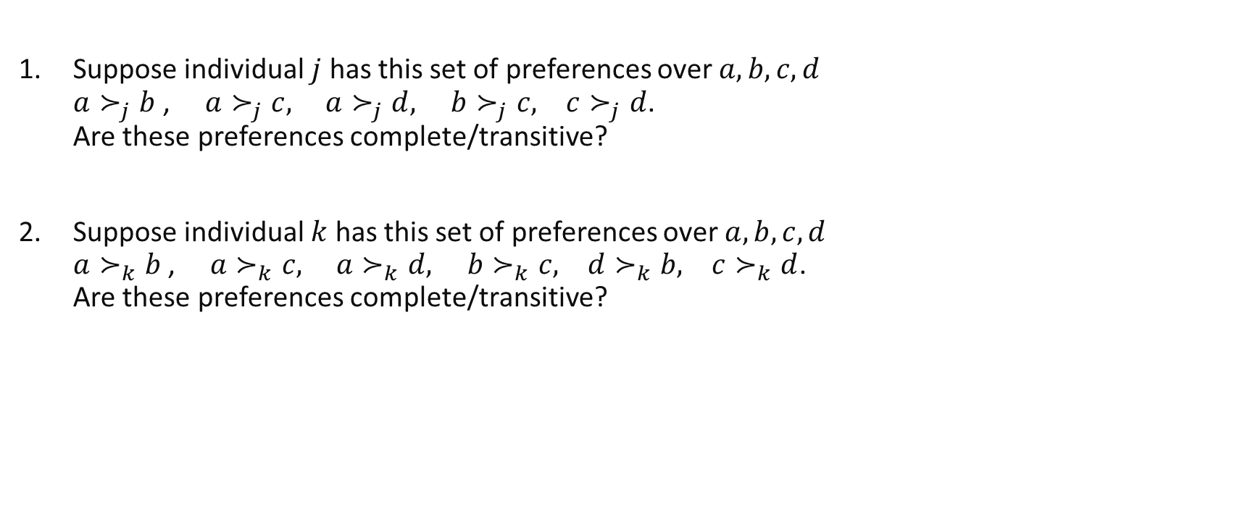
Review questions 1
Suppose individual $j$ has this set of preferences over $a,b,c,d$ $a≻_{j}b$, ${a≻}_{j}c,$ ${a≻}_{j}d,$ $b≻_{j}c, c≻_{j}d$. Are these preferences complete/transitive?
Suppose individual $k$ has this set of preferences over $a,b,c,d$ $a≻_{k}b$, ${a≻}_{k}c,$ ${a≻}_{k}d,$ $b≻_{k}c, d≻_{k}b, c≻_{k}d$. Are these preferences complete/transitive?

Slide 11
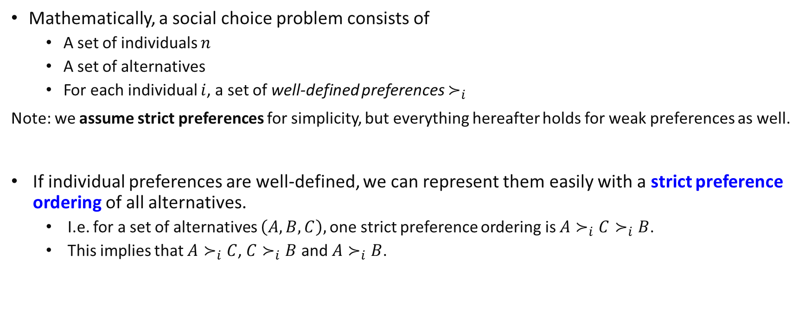
Social Choice
Mathematically, a social choice problem consists of
A set of individuals $n$
A set of alternatives
For each individual $i$, a set of well-defined preferences $≻_{i}$
Note: we assume strict preferences for simplicity, but everything hereafter holds for weak preferences as well.
If individual preferences are well-defined, we can represent them easily with a strict preference ordering of all alternatives.
I.e. for a set of alternatives $\left(A,B,C\right),$one strict preference ordering is $A≻_{i}C≻_{i}B$.
This implies that $A≻_{i}C$, ${C≻}_{i}B$and $A≻_{i}B$.

Slide 12
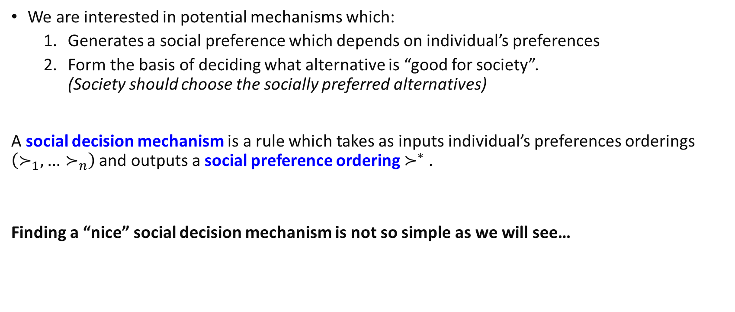
Social Choice
We are interested in potential mechanisms which:
Generates a social preference which depends on individual’s preferences
Form the basis of deciding what alternative is “good for society”. (Society should choose the socially preferred alternatives)
A social decision mechanism is a rule which takes as inputs individual’s preferences orderings $\left(≻_{1},…≻_{n}\right)$ and outputs a social preference ordering $≻^{∗}$ .
Finding a “nice” social decision mechanism is not so simple as we will see…

Slide 13
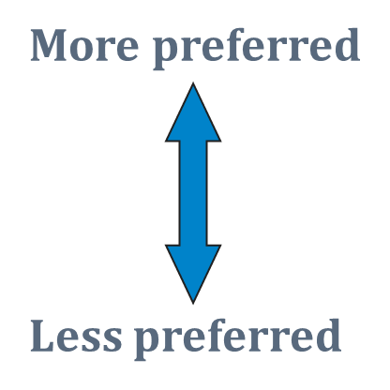
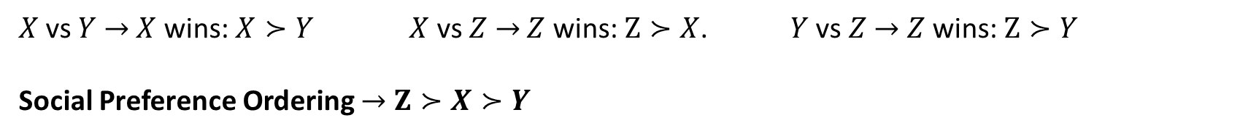
Example 1a: Pairwise Majority Voting
Rule: For each pair, we consider which will win in a majority vote.
Harry | Ron | Hermione
X | Z | Z
Y | Y | X
Z | X | Y
$X$vs $Y$ $→$ $X$ wins: $X≻Y$ $X$ vs $Z$ $→$ $Z$ wins: $Z≻X$. $Y$ vs $Z$ $→$ $Z$ wins: $Z≻Y$
Social Preference Ordering $→$ $Z≻X≻Y$

Slide 14
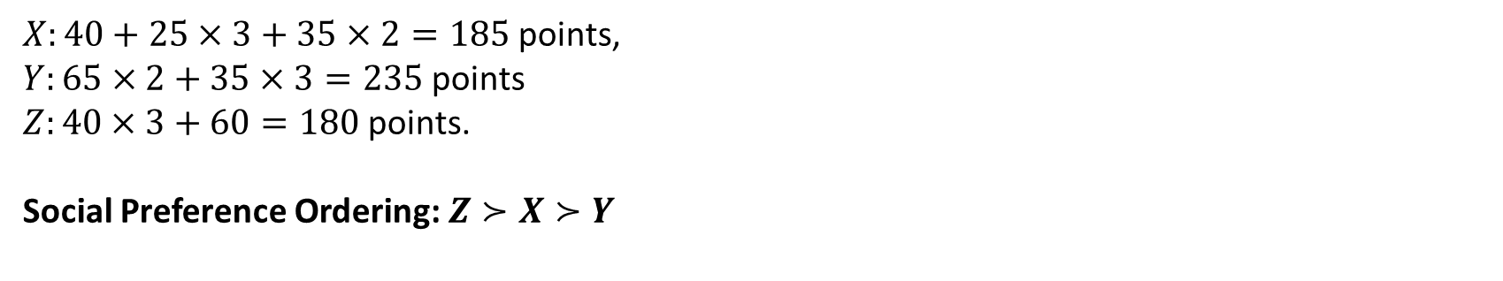
Example 2a: Borda Count (Rank order voting)
Rule: Each individual assigns a rank to the alternatives.. 1st will get $1$ point, … $m$th will get $m$ points... The outcome with the least points is the most socially preferred.
Rank | (Type 1) 40% | (Type 2) 25% | (Type 3) 35%
1 | X | Z | Z
2 | Y | Y | X
3 | Z | X | Y
100 individuals, with
3 different types of preferences
$X:40+25×3+35×2=185$ points,
$Y:65×2+35×3=235$ points
$Z:40×3+60=180$ points.
Social Preference Ordering: $Z≻X≻Y$

Slide 15
Condorcet Cycle
Do the previously discussed social decision mechanisms always work “properly”?
Let’s look at a scenario where individuals preferences involve a Condorcet Cycle:
(Type 1) | (Type 2) | (Type 3)
X | Z | Y
Z | Y | X
Y | X | Z

Slide 16
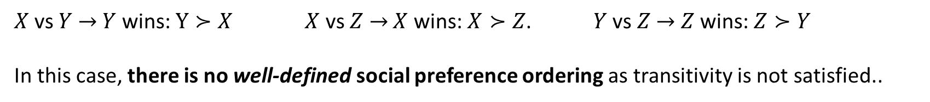
Example 1b: Pairwise Majority Voting
Harry | Ron | Hermione
X | Z | Y
Z | Y | X
Y | X | Z
$X$vs $Y$ $→$ $Y$ wins: $Y≻X$ $X$ vs $Z$ $→$ $X$ wins: $X≻Z$. $Y$ vs $Z$ $→$ $Z$ wins: $Z≻Y$
In this case, there is no well-defined social preference ordering as transitivity is not satisfied..

Slide 17
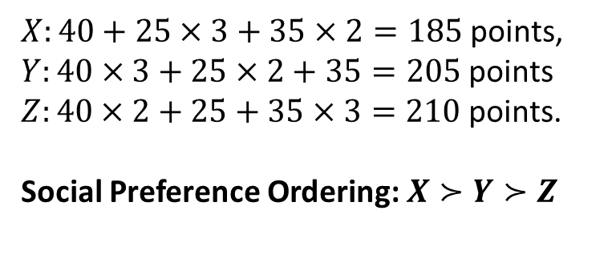
Example 2b: Borda Count (Rank order voting)
Rank | (Type 1) 40% | (Type 2) 25% | (Type 3) 35%
1 | X | Z | Y
2 | Z | Y | X
3 | Y | X | Z
100 individuals, with
3 different types of preferences
$X:40+25×3+35×2=185$ points,
$Y:40×3+25×2+35=205$ points
$Z:40×2+25+35×3=210$ points.
Social Preference Ordering: $X≻Y≻Z$

Slide 18
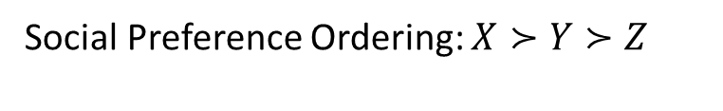
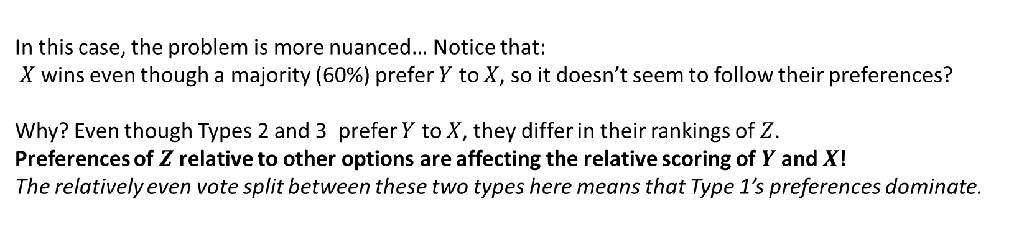
Example 2b: Borda Count (Rank order voting)
Rank | (Type 1) 40% | (Type 2) 25% | (Type 3) 35%
1 | X | Z | Y
2 | Z | Y | X
3 | Y | X | Z
100 individuals, with
3 different types of preferences
Social Preference Ordering: $X≻Y≻Z$
In this case, the problem is more nuanced… Notice that: $X$ wins even though a majority (60%) prefer $Y$ to $X$, so it doesn’t seem to follow their preferences?
Why? Even though Types 2 and 3 prefer $Y$ to $X$, they differ in their rankings of $Z$. Preferences of $Z$ relative to other options are affecting the relative scoring of $Y$ and $X$!
The relatively even vote split between these two types here means that Type 1’s preferences dominate.
Notes:
X has 40 + 75 +70 = 185
Y has 120+50+35=205
Z has 80+25 +105=210

Slide 19
Properties of Social Decision Mechanisms

Slide 20
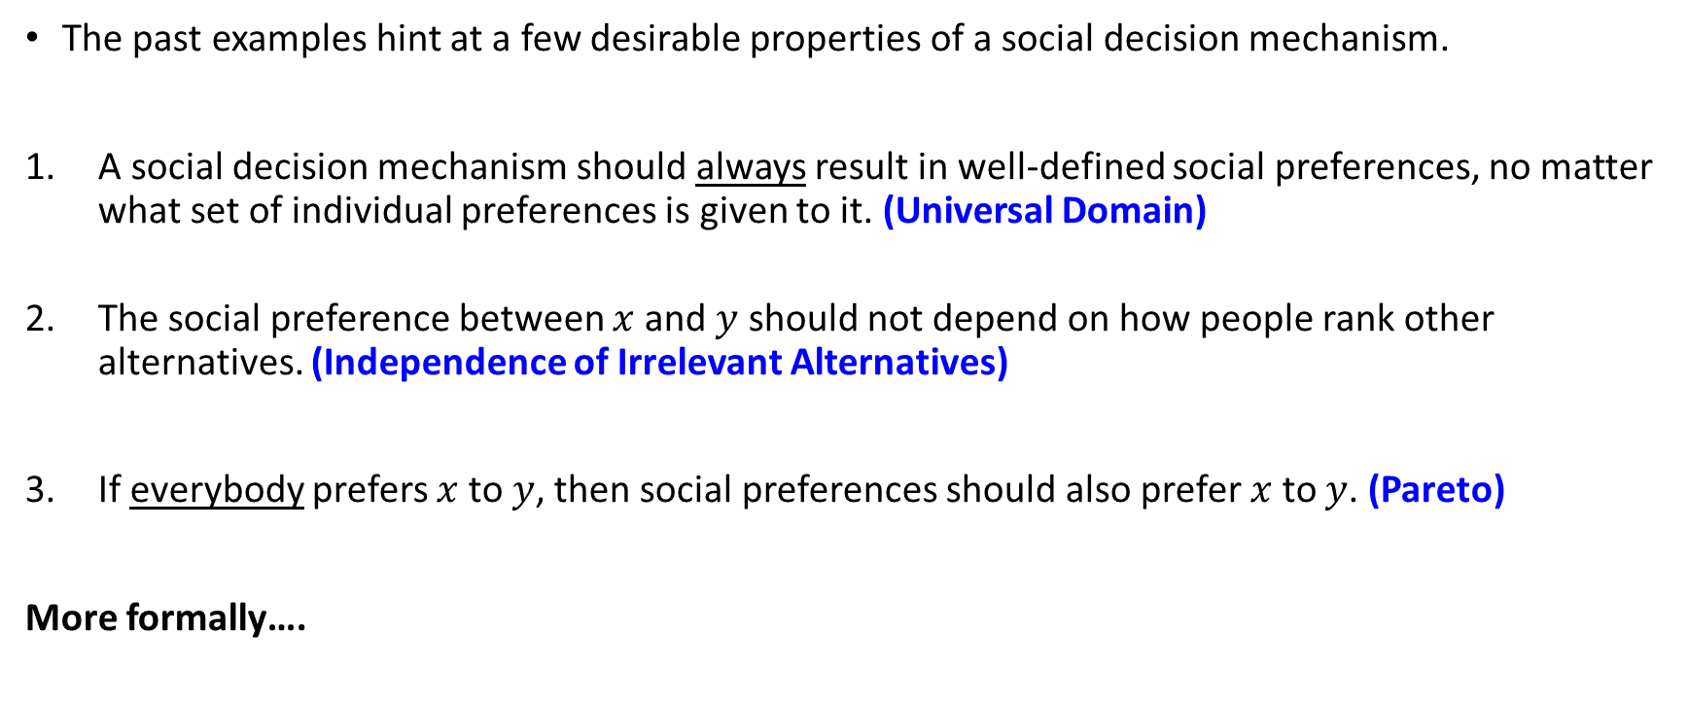
Desirable properties of a SDM
The past examples hint at a few desirable properties of a social decision mechanism.
A social decision mechanism should always result in well-defined social preferences, no matter what set of individual preferences is given to it. (Universal Domain)
The social preference between $x$ and $y$ should not depend on how people rank other alternatives. (Independence of Irrelevant Alternatives)
If everybody prefers $x$ to $y$, then social preferences should also prefer $x$ to $y$. (Pareto)
More formally….

Slide 21
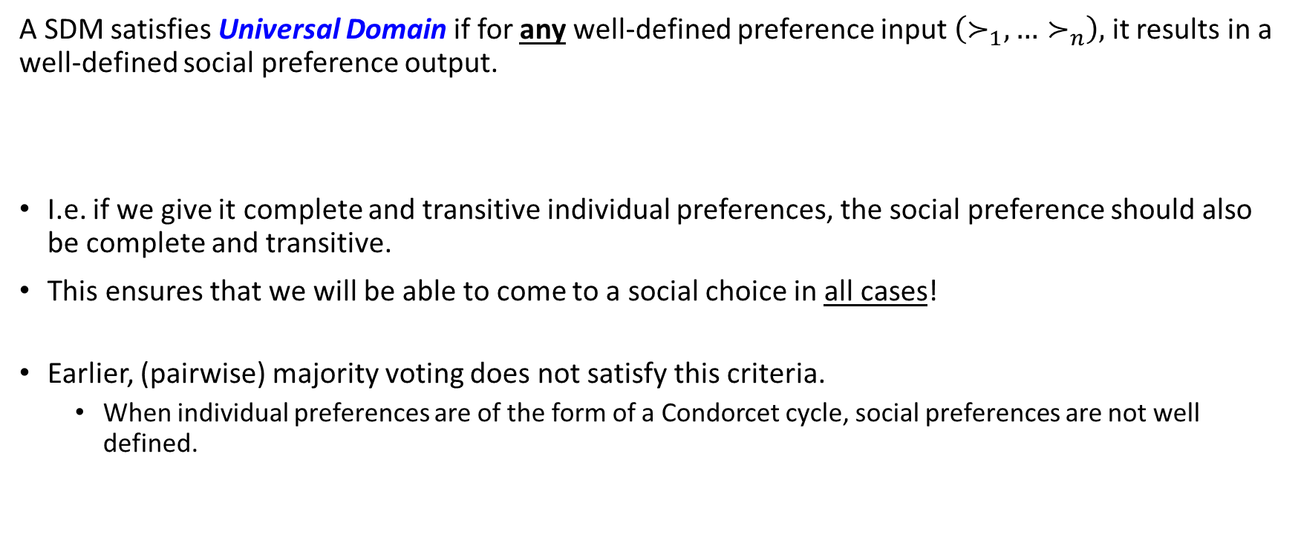
Universal Domain
A SDM satisfies Universal Domain if for any well-defined preference input $\left(≻_{1},…≻_{n}\right),$ it results in a well-defined social preference output.
I.e. if we give it complete and transitive individual preferences, the social preference should also be complete and transitive.
This ensures that we will be able to come to a social choice in all cases!
Earlier, (pairwise) majority voting does not satisfy this criteria.
When individual preferences are of the form of a Condorcet cycle, social preferences are not well defined.

Slide 22
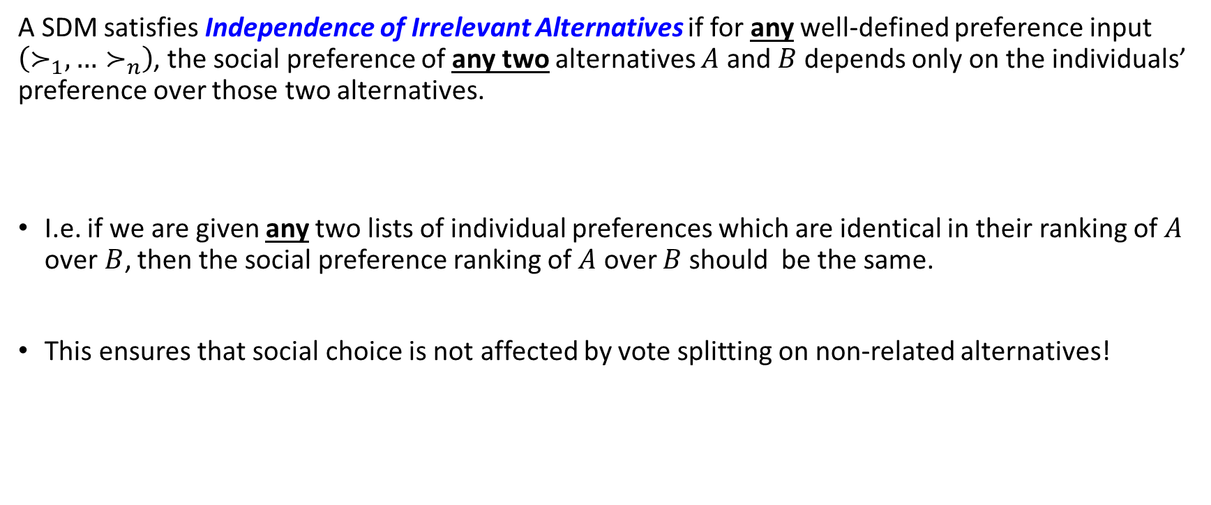
Independence of Irrelevant Alternatives
A SDM satisfies Independence of Irrelevant Alternatives if for any well-defined preference input $\left(≻_{1},…≻_{n}\right)$, the social preference of any two alternatives $A$ and $B$ depends only on the individuals’ preference over those two alternatives.
I.e. if we are given any two lists of individual preferences which are identical in their ranking of $A$ over$B$, then the social preference ranking of $A$ over $B$ should be the same.
This ensures that social choice is not affected by vote splitting on non-related alternatives!

Slide 23
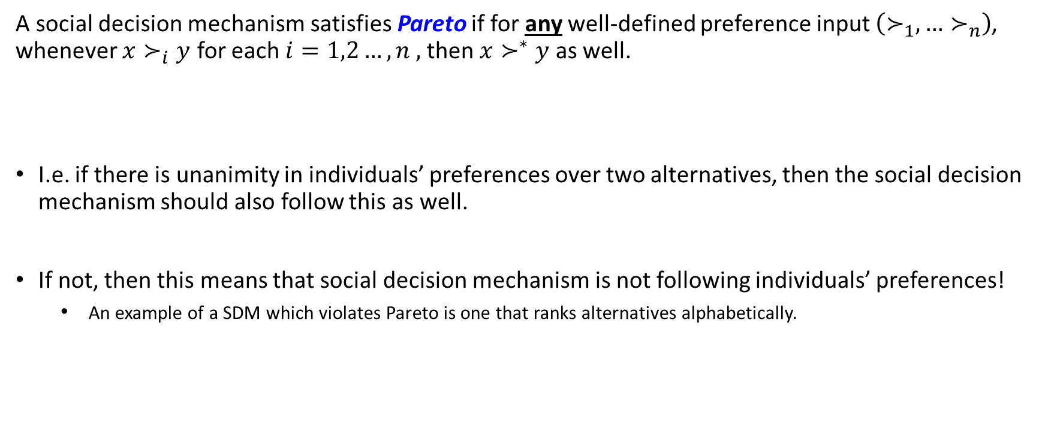
Pareto
A social decision mechanism satisfies Pareto if for any well-defined preference input $\left(≻_{1},…≻_{n}\right)$, whenever $x≻_{i}y$ for each $i=1,2…,n ,$then $x≻^{∗}y$ as well.
I.e. if there is unanimity in individuals’ preferences over two alternatives, then the social decision mechanism should also follow this as well.
If not, then this means that social decision mechanism is not following individuals’ preferences!
An example of a SDM which violates Pareto is one that ranks alternatives alphabetically.

Slide 24

Checking the properties of a SDM..
To say that these properties hold, we need to check that the conditions which they specify are true for any set of individual preferences $(≻_{1},≻_{2}…. ≻_{n})$
If it is possible to find a single example of a set of individual preferences where the property does not hold, then the property does not hold!
Let us try the example of the pairwise majority voting social decision mechanism.

Slide 25

Checking the properties of a SDM.. Pairwise Majority Voting example
Universal Domain: In the earlier slide, we gave a counterexample where a set of well-defined individual preferences does not result in a well-defined social preference. Not satisfied!
Independence of Irrelevant Alternatives: The social preference between any pair $x$and $y$ depends in a majority vote only depends on how individuals vote according to their individual preference over only $x$ and $y$. Satisfied!
Pareto: For any set of preferences where everyone individually prefers an alternative $x$ to an alternative $y$, then everyone will vote for $x.$ Hence, in a majority vote, the social preference will be $x≻^{∗}y$. Satisfied!

Slide 26
Review questions 2
Consider the pairwise minority voting rule where for each pair, we let the socially preferred option be the one which loses in a majority vote. Does it satisfy the following conditions?
Universal Domain
Independence of Irrelevant Alternatives
Pareto

Slide 27
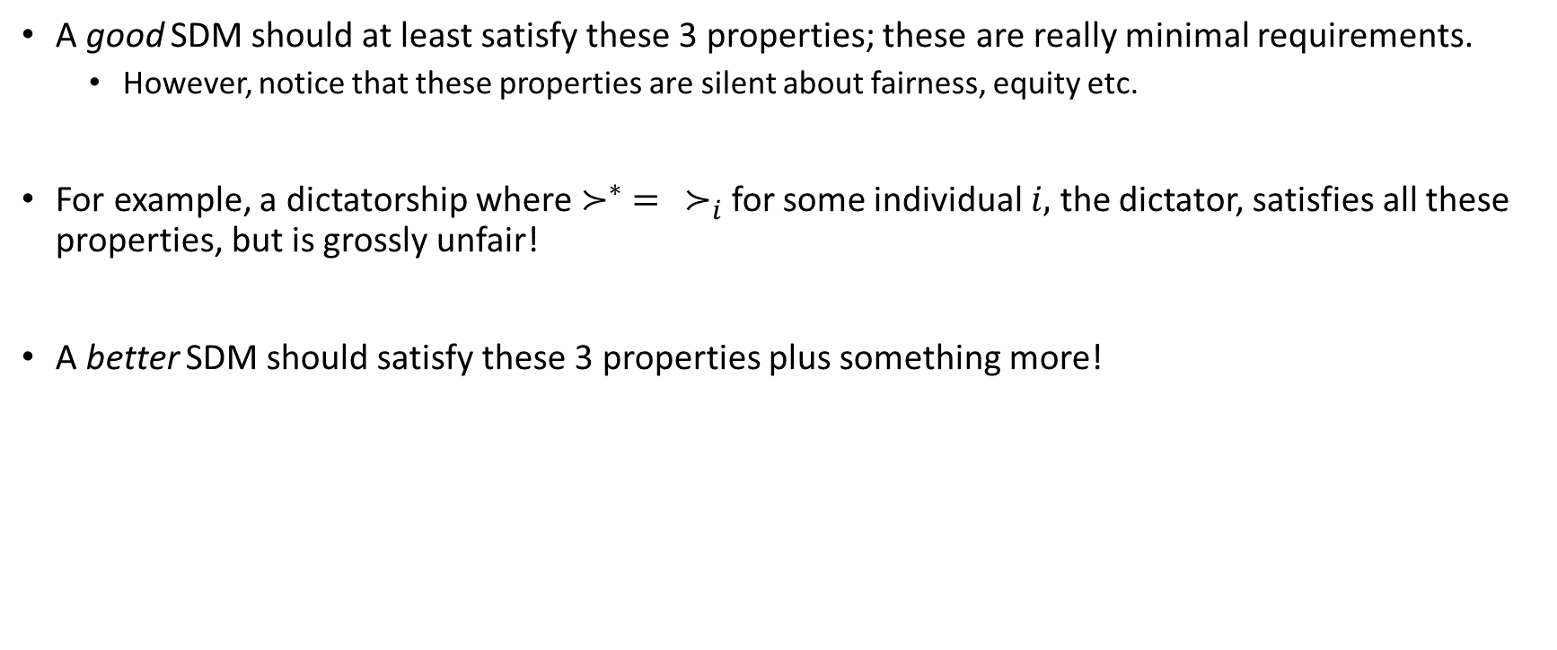
Other properties of a SDM?
A good SDM should at least satisfy these 3 properties; these are really minimal requirements.
However, notice that these properties are silent about fairness, equity etc.
For example, a dictatorship where $≻^{∗} = ≻_{i}$ for some individual $i,$ the dictator, satisfies all these properties, but is grossly unfair!
A better SDM should satisfy these 3 properties plus something more!

Slide 28
Arrow’s Impossibility Theorem

Slide 29
Arrow’s Impossibility Theorem
These 3 conditions seem to be reasonable qualities of a good social decision mechanism.
However, it is actually difficult to find a fair mechanism that satisfies all of them.
In fact, Kenneth Arrow has shown the following remarkable result:
Arrow’s Impossibility Theorem
Suppose there are at least 3 alternatives. If a social decision mechanism satisfies properties 1, 2 and 3, then it must be a dictatorship.

Slide 30
Remarks
This suggests that our 3 plausible features are inconsistent with democracy??!
We haven’t even considered whether the SDMs are manipulation proof or truthful !
One possible solution to avoid the dictatorial outcome would be to give up one of these:
Universal Domain (UD)
Pareto
Independence of irrelevant alternatives (IIA)
Amongst these 3 conditions, the literature discusses altering IIA or the UD condition, but none have talked about dropping the Pareto condition. Why? This implies going against the wishes of society!

Slide 31
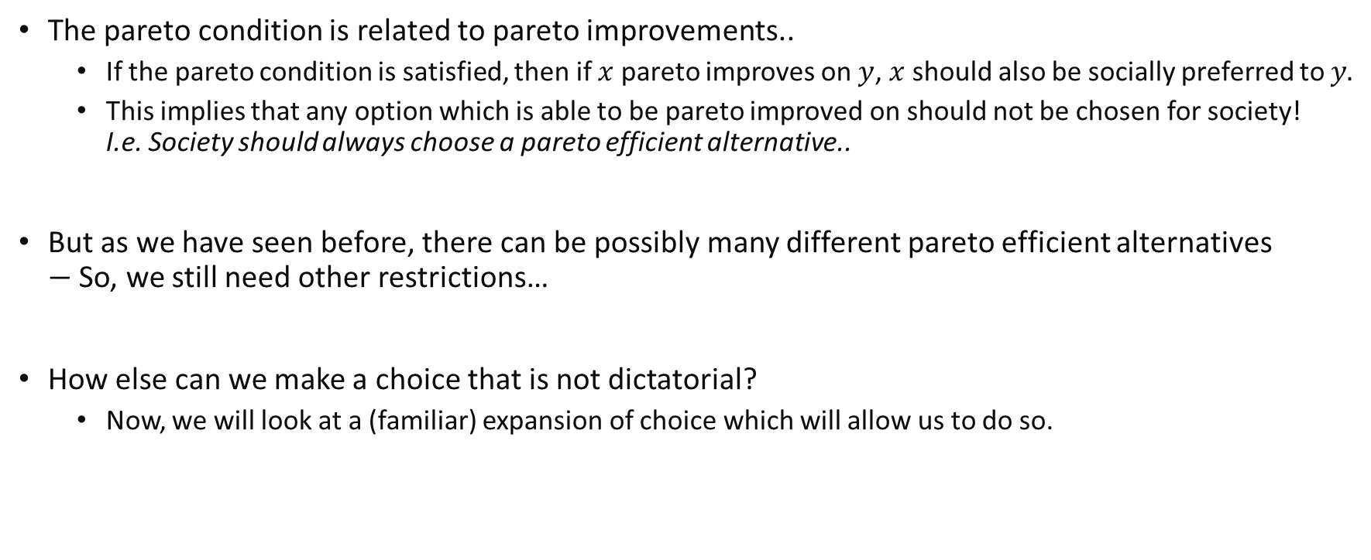
The Pareto Condition and Pareto Efficiency
The pareto condition is related to pareto improvements..
If the pareto condition is satisfied, then if $x$ pareto improves on $y$, $x$ should also be socially preferred to $y.$
This implies that any option which is able to be pareto improved on should not be chosen for society! I.e. Society should always choose a pareto efficient alternative..
But as we have seen before, there can be possibly many different pareto efficient alternatives $−$ So, we still need other restrictions…
How else can we make a choice that is not dictatorial?
Now, we will look at a (familiar) expansion of choice which will allow us to do so.
Notes:
Use the definition of pareto dominance to get the if x pareto dominates y, then if pareto condition holds, x should be socially preferred to y.

Slide 32
Cardinal Preferences and Social Welfare Functions

Slide 33
Ordinal and Cardinal preferences
Notice that Arrow’s Impossibility Theorem considers only ordinal preferences. What if we can make use of cardinal preferences?
Ordinal preferences: people only have rankings over items.
E.g. I like A more than B, or I am indifferent between A and B.
Cardinal preferences: people have preference “intensities”
E.g. I like A much more than B, more than how much I like C more than D.
In fact, you should be very familiar with cardinal preferences: utility functions!

Slide 34
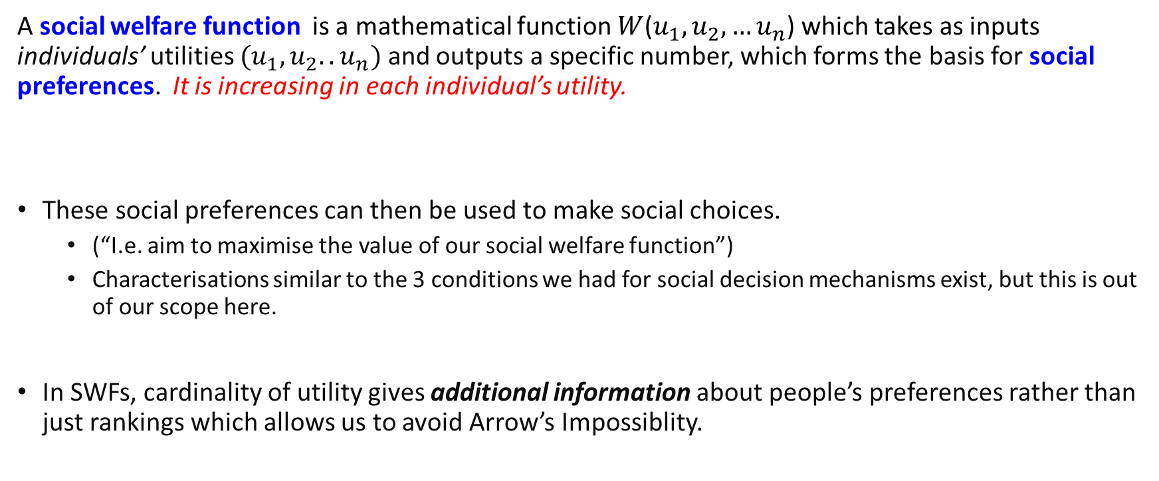
Social Welfare Functions
A social welfare function is a mathematical function $W$($u_{1},u_{2},…u_{n}$) which takes as inputs individuals’ utilities $(u_{1},u_{2}..u_{n})$ and outputs a specific number, which forms the basis for social preferences. It is increasing in each individual’s utility.
These social preferences can then be used to make social choices.
(“I.e. aim to maximise the value of our social welfare function”)
Characterisations similar to the 3 conditions we had for social decision mechanisms exist, but this is out of our scope here.
In SWFs, cardinality of utility gives additional information about people’s preferences rather than just rankings which allows us to avoid Arrow’s Impossiblity.
Notes:
Note: this means that utility has to have some cardinal meaning here.
Typically, it is just an ordinal measure..

Slide 35
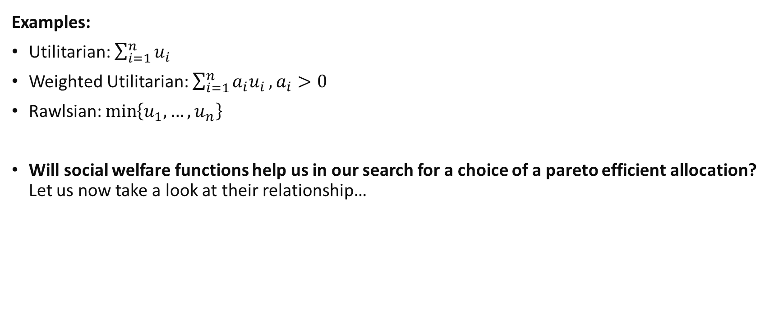
Social Welfare Functions
Examples:
Utilitarian: $\sum_{i=1}^{n}{u_{i}}$
Weighted Utilitarian: $\sum_{i=1}^{n}{{a_{i}u}_{i}}, a_{i}>0$
Rawlsian: $\min\left\{u_{1},…,u_{n}\right\}$
Will social welfare functions help us in our search for a choice of a pareto efficient allocation? Let us now take a look at their relationship…
Notes:
Utilitarian is often called the Benthamite welfare function after Jeremy Bentham. Minimax is often called the Rawlsian welfare function after John Rawls.
Utilitarian is a special case of the weighted utilitarian function.
One of the cases for which we were interested in social welfare functions was because we wanted to be able to choose which allocation in the pareto set we wanted to attain.

Slide 36
Social Optima and Pareto Efficiency

Slide 37
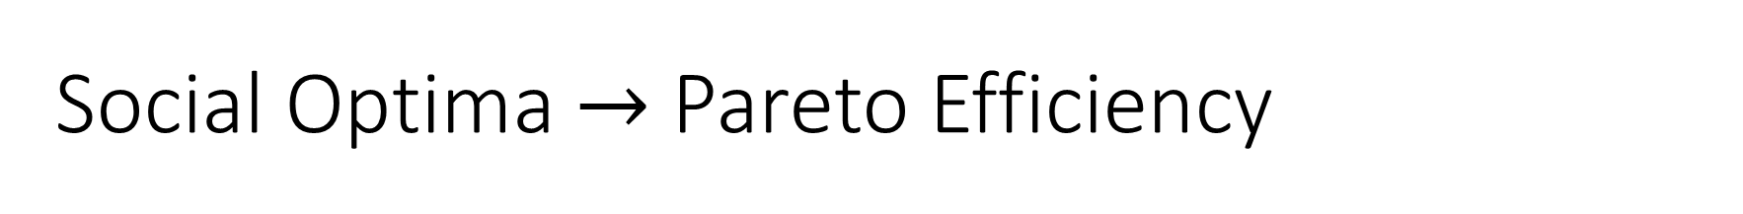
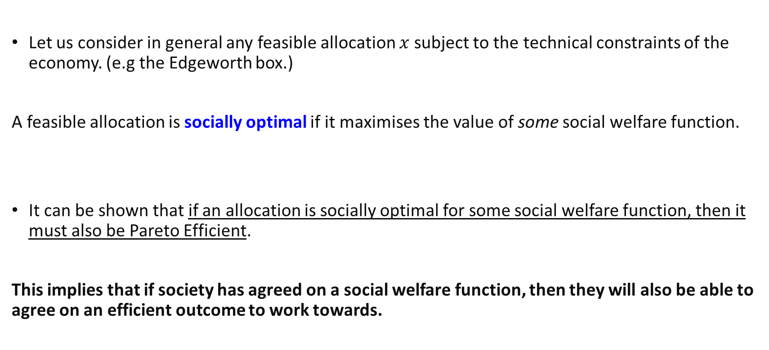
Social Optima $→$ Pareto Efficiency
Let us consider in general any feasible allocation $x$ subject to the technical constraints of the economy. (e.g the Edgeworth box.)
A feasible allocation is socially optimal if it maximises the value of some social welfare function.
It can be shown that if an allocation is socially optimal for some social welfare function, then it must also be Pareto Efficient.
This implies that if society has agreed on a social welfare function, then they will also be able to agree on an efficient outcome to work towards.
Notes:
This tells us that if we focus on a socially optimal allocation, then we will arrive at of the allocations in the pareto set.

Slide 38
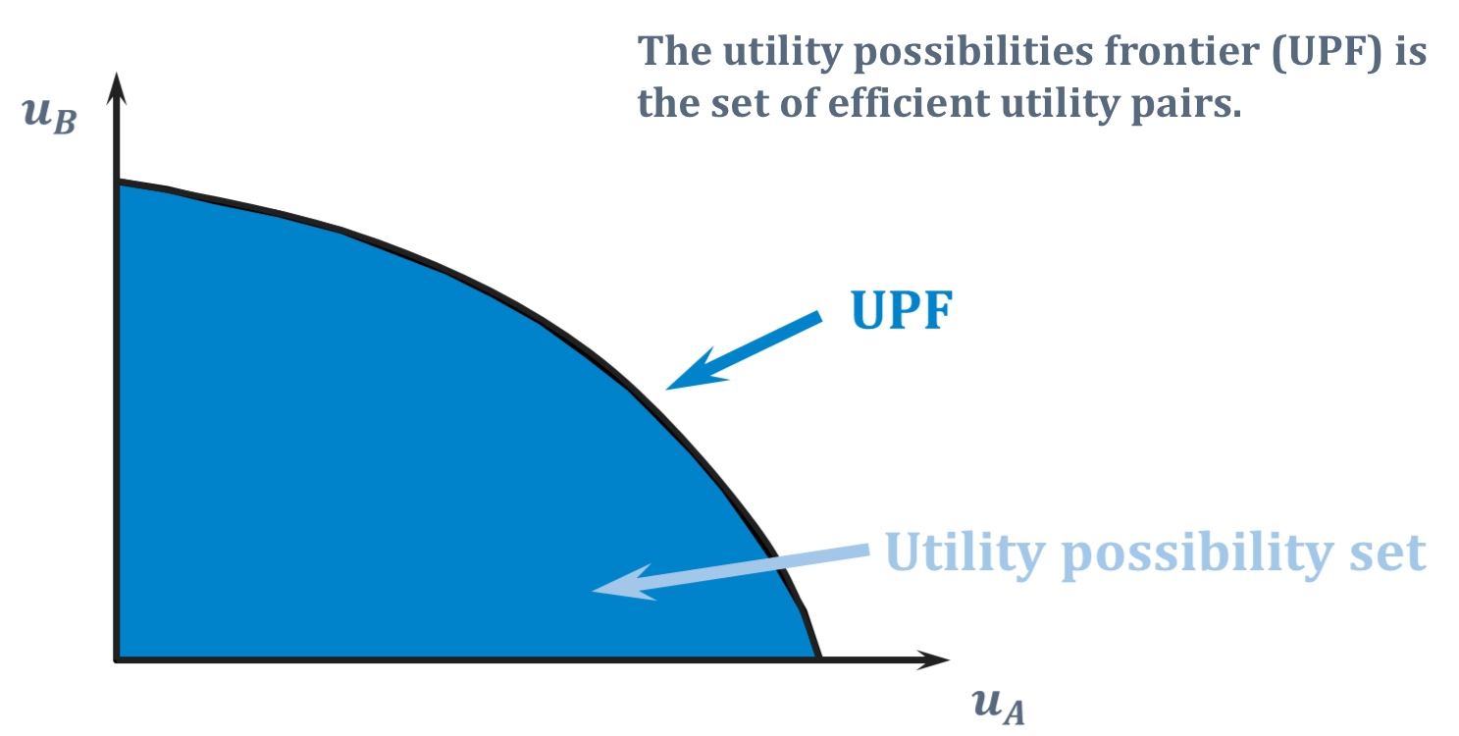
Utility Possibilities
To visualize this, let us consider the utility possibility set: the set of utilities of outcomes that are available given economy constraints. Its frontier is pareto efficient (why?).
Notes:
On the frontier, we can only make someone better off by sacrificing utility of another.

Slide 39
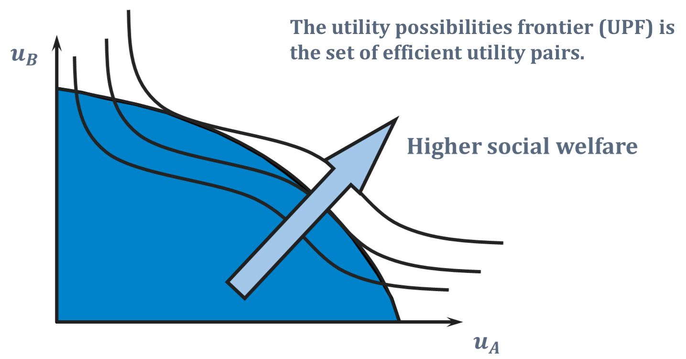
Maximising Social Welfare
Iso-Welfare curves

Slide 40
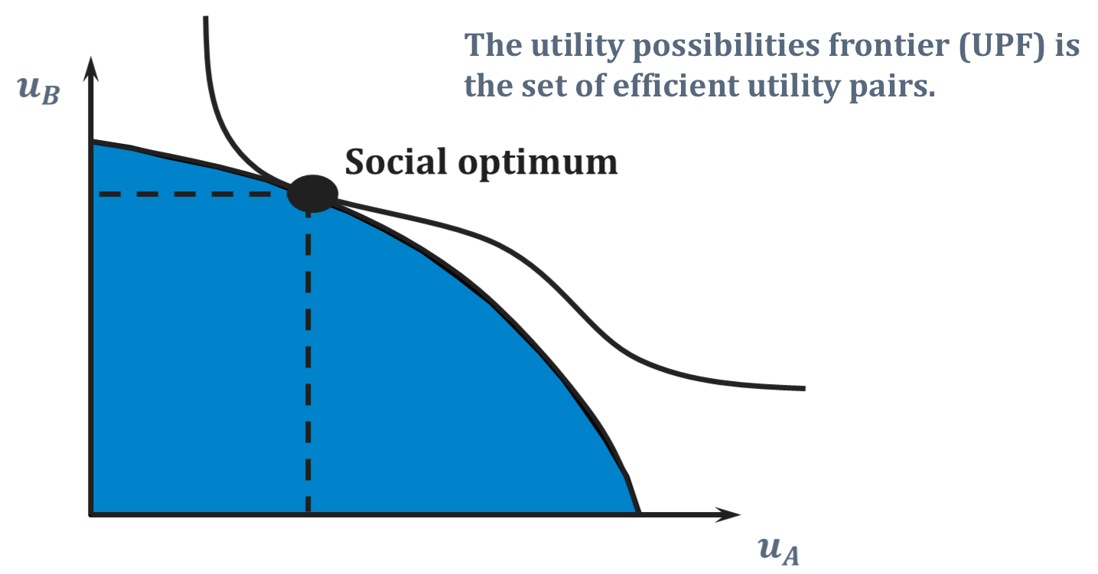
Social Optima $→$ Pareto Efficiency
Social optimum lies on pareto frontier and is hence pareto efficient.
This result can also be shown mathematically (see appendix)

Slide 41
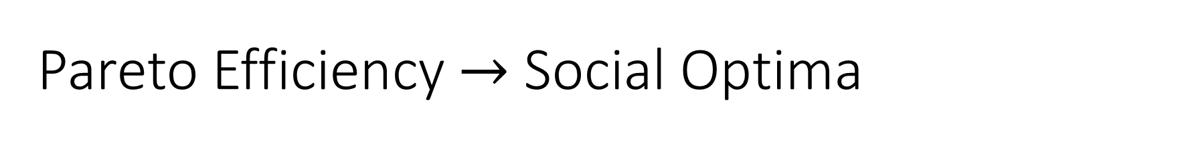
Pareto Efficiency $→$ Social Optima
The converse statement is also true!
It holds for more general structures of individual’s preferences, though they cannot be too “weird”.
Otherwise, the utility possibility set will have a “weird shape” as well.
Hence, if an allocation is pareto efficient, then it is also socially optimal for some social welfare function.
This implies that for any pareto efficient outcome, we do not need to worry about there not being some social welfare function which “supports” it.

Slide 42
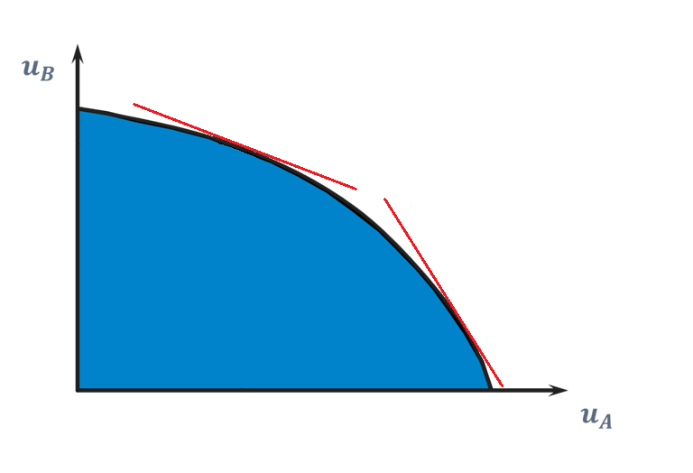
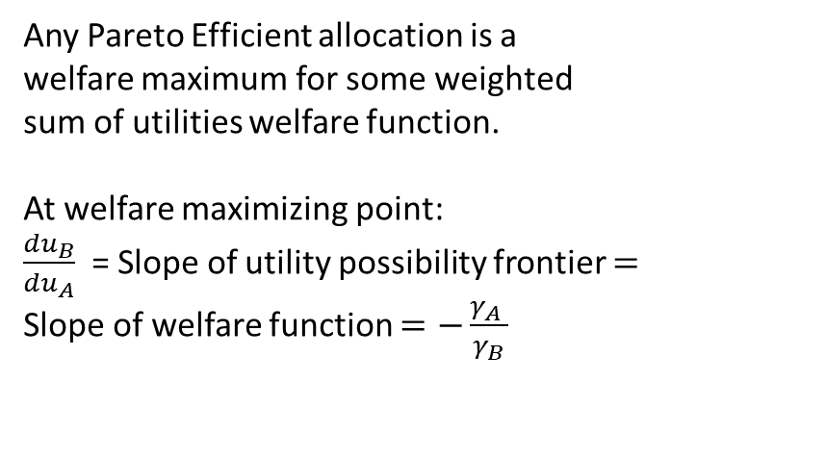


Pareto Efficiency $→$ Social Optima
Any Pareto Efficient allocation is a
welfare maximum for some weighted
sum of utilities welfare function.
At welfare maximizing point:
$\frac{du_{B}}{du_{A}}$ = Slope of utility possibility frontier $=$
Slope of welfare function $=−\frac{γ_{A} }{γ_{B}}$
$$W\left(u_{A},u_{B}\right)=γ_{A}u_{A}+γ_{B}u_{B}$$
$$W\left(u_{A}′,u_{B}′\right)=γ_{A}′u_{A}′+γ_{B}′u_{B}′$$

Slide 43
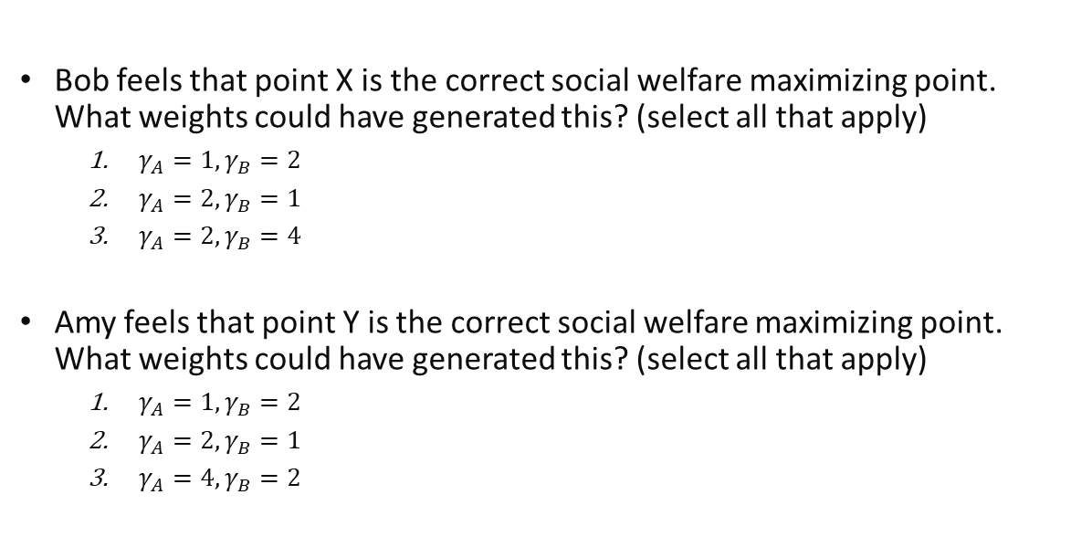


Review questions 3
Amy and Bob both believe that the ideal allocation is given by maximising an appropriate weighted utilitarian function. $W\left(u_{A},u_{B}\right)=$ $γ_{A}u_{A}+γ_{B}u_{B}$.
Bob feels that point X is the correct social welfare maximizing point. What weights could have generated this? (select all that apply)
$γ_{A}=1,γ_{B}=2$
$γ_{A}=2,γ_{B}=1$
$γ_{A}=2,γ_{B}=4$
Amy feels that point Y is the correct social welfare maximizing point. What weights could have generated this? (select all that apply)
$γ_{A}=1,γ_{B}=2$
$γ_{A}=2,γ_{B}=1$
$γ_{A}=4,γ_{B}=2$
$$slope=−\frac{1}{2}$$
X
Y
$$slope=−2$$

Slide 44
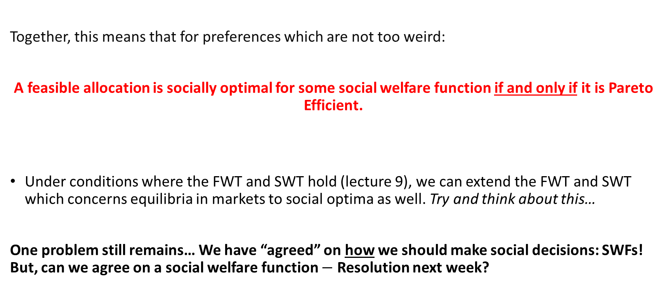

Pareto Efficiency $↔$ Social Optima
Together, this means that for preferences which are not too weird:
A feasible allocation is socially optimal for some social welfare function if and only if it is Pareto Efficient.
Under conditions where the FWT and SWT hold (lecture 9), we can extend the FWT and SWT which concerns equilibria in markets to social optima as well. Try and think about this…
One problem still remains… We have “agreed” on how we should make social decisions: SWFs! But, can we agree on a social welfare function $−$ Resolution next week?

Slide 45
Key learning outcomes
Understand the definitions involved with individual preferences.
What is the difference between Social Decision Mechanisms and Social Welfare Functions?
What are “good” properties of SDMs: why is the rationale behind them and how do we test them?
Why might SDMs be insufficient for social choice?
Understand the link between pareto efficiency and social optimality and how to graphically show it.
Notes:
Of course, getting to an agreement on a social welfare function is a problem on its own. But the benefit is that it we can always make reasonable decisions based on it.

Slide 46
Announcement
Quiz 6 will be released today. It will cover this week and last week’s lectures.
Deadline will be next Wednesday.
Bi-semester test on Week 13, during Lecture Timing --- more details closer to the date.

Slide 47
Readings
Varian, Chapter 34.
Varian, Chapter 3: Background on preferences (optional)
Wikipage: Arrow’s Impossibility Theorem (optional)
Binmore, Natural Justice (optional): an economic discussion on moral philosophy and its relation to social welfare functions.

